Slide 1
SQL Server Central Webinar Series # 5:
Setup Your Source Control With Help from PowerShell.
Thanks for coming along to the webinar.
Things will get started shortly…
Notes:
November 18th 2010

Slide 2
SQL Server Central Webinar Series # 5:
Setup Your Source Control With Help from PowerShell.
Steve Jones,
SQL Server MVP and Editor-in-Chief of SQLServerCentral.com

Slide 3
About Me
SQL Server Consultant with UpSearch
Over 35 years in IT
Career covered multiple disciplines – operations, development, telecommunications, network design/administration and database design and administration
Started using Sybase in 1992, MS SQL Server in 1995
Microsoft Certified IT Professional: Database Administrator and Database Developer, Microsoft Certified Trainer (MCT)
Awarded Microsoft MVP Award for SQL Server for last 4 years

Slide 4
Part 1: Introduction to PowerShell
Cmdlets
Aliases
The Pipeline
Variables
Objects
Control Flow

Slide 5
Cmdlets
Cmdlets are Command-Line Utilities built into PowerShell
They add functionality to the command line
They use a Verb-Noun Naming Convention
Get-Process
Stop-Service
Export-Csv
Arguments begin with "-" character
Get-Process -name sqlservr
Help is available with the Get-Help cmdlet
List of all available cmdlets also available
Get-Command

Slide 6
Aliases
Allows shorthand version of cmdlet
Use names familiar to you
Get-Childitem
dir
ls
Get-Process
ps
Get-WMIObject
gwmi
Get-Alias returns a list of the defined aliases
New-Alias allows you define your own aliases

Slide 7
The Pipeline
Takes cmdlet output and sends it to the next cmdlet
get-process | sort-object workingset -descending | select-object -first 10
Unlike Unix pipeline - no "sed", "awk" or "grep"
Output of cmdlets are objects
Cmdlets expect objects for input

Slide 8
Variables
Give us a place to put values for later use
Defined by a name preceded by a dollar sign ("$") character
Assigned a value via the equal sign ("=") character
$i = 7
Creates an object of type integer
Technically of type System.Int32

Slide 9
Objects
Have a defined type
Types have sets of defined Properties and Methods
Properties are settings and can contain other individual objects
Methods are sets of tasks or functions that can be performed on the type
$s = 'Cleveland Rocks!'
$s | Get-Member
$s.Length

Slide 10
Collections
Often referred to as arrays
Collection infers a group of objects
Arrays (to me) refer to a set of values
Easy to create a collection
$m = 1,4,6,8,9
To get the third value in the collection
$m[2]
To specify a contiguous set of values
$n = 1..5

Slide 11
String Variables
Sometimes we want to substitute a variable into a string
For example, a dynamic connection string
$cstrng = "Data Source=$instance;Integrated Security=SSPI;Initial Catalog=$database"
Using double-quotes variable substitution takes place
Sometimes that's not good
$inst = 'MSSQL$INST01'
Using single-quotes no substitution is performed

Slide 12
String Variables Part II
When you want to build a long string
$q = "SELECT TOP 25 [ContactID]"
$q = $q + " ,[FirstName]"
$q = $q + " ,[LastName]"
$q = $q + " ,[EmailAddress]"
$q = $q + " ,[Phone]"
$q = $q + " FROM [AdventureWorks].[Person].[Contact]"
Or you can use a "here-string"
$q = @"
SELECT TOP 25 [ContactID]
,[FirstName]
,[LastName]
,[EmailAddress]
,[Phone]
FROM [AdventureWorks].[Person].[Contact]
"@

Slide 13
Control Flow
Need a way to control the logic flow
Need to identify a set of commands that are to be run together
A "script block" identifies the boundaries by curly-brace characters ("{" and "}")
Script blocks
Can be nested
Don't need to be part of a conditional operator
Can be used anywhere
Comments are allowed, are identified by the pound-sign (or hash) character ("#")
Multi-line comments are allowed in PS 2 and up using "<#" and "#>" as delimiters

Slide 14
Comparison Operators
Operator | Description
-eq | equal to
-ne | not equal to
-gt | greater than
-ge | greater than or equal to
-lt | less than
-le | less than or equal to
-like | wildcard pattern matching
-and | logical and
-or | logical or

Slide 15
Conditional Operators
Command | Example
If | if ($val -eq "target") { #work }
For | For ($i=0; $i -lt 10; $i++) { #work }
ForEach | ForEach ($obj in $coll) { #work }
While | While ($val -eq "target") { #work }

Slide 16
Conditional Operators
Command | Example
Do Until | Do { #work } Until ($val -eq "target")
Do While | Do { #work } While ($val -eq "target")
Switch | Switch ($val) { "Val1" { #work } "Val2" { #work } }

Slide 17
Control Flow Cmdlets
Cmdlet | Description | Alias
ForEach-Object | Iterates through each member in the collection | %
Where-Object | Conditionally filters objects | ?
Select-Object | Pipes the specified properties | select
Sort-Object | Sorts objects | sort
Tee-Object | Sends objects in two directions | tee

Slide 18
Part 2: Introduction to SMO
Introduction to the SMO Library
The SMO Object Model

Slide 19
Introduction to the SMO Library
SMO – Server Management Objects
Redesigned from predecessor – DMO
Distributed Management Objects – SQL 2000 and earlier
Provides a SQL Server Management API
You can manage SQL Server via VB.Net, C# and PowerShell
Provides access to properties not available in T-SQL
Loaded via DLLs installed with Client tools
C:\Program Files\Microsoft SQL Server\100\SDK\Assemblies
Microsoft.SqlServer.Smo.dll
Microsoft.SqlServer.SmoExtended.dll
Microsoft.SqlServer.SqlWmiManagement.dll

Slide 20
Loading the SMO Library
To load the core SMO DLL into your script,load an assembly
[System.Reflection.Assembly]::LoadWithPartialName('Microsoft.SqlServer.SMO') | out-null
SQL Server 2008 split functions into new DLLs
To test the version and load the new DLLs
$v = [System.Reflection.Assembly]::LoadWithPartialName( 'Microsoft.SqlServer.SMO')
if ((($v.FullName.Split(','))[1].Split('='))[1].Split('.')[0] -ne '9') { [System.Reflection.Assembly]::LoadWithPartialName('Microsoft.SqlServer.SMOExtended') | out-null
[System.Reflection.Assembly]::LoadWithPartialName('Microsoft.SqlServer.SQLWMIManagement') | out-null
}

Slide 21
Connect to the Server
Connect to SQL Server by instantiating a Server object
$svr = New-Object ('Microsoft.SqlServer.Management.Smo.Server') 'SQLTBWS\INST01'
Access the SQL Server WMI objects by instantiating a ManagedComputer object at the Windows server level
$mgt = New-Object ('Microsoft.SqlServer.Management.Smo.WMI.ManagedComputer') 'SQLTBWS'

Slide 22
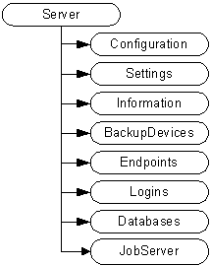
The SMO Object Model

Slide 23
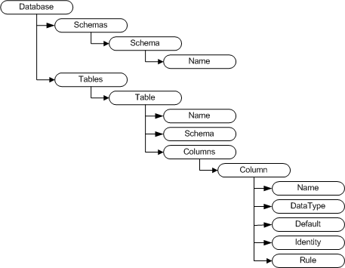
The Database Object - Tables

Slide 24
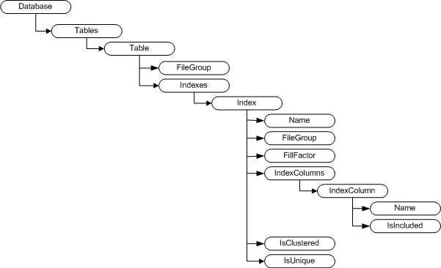
The Database Object - Tables

Slide 25
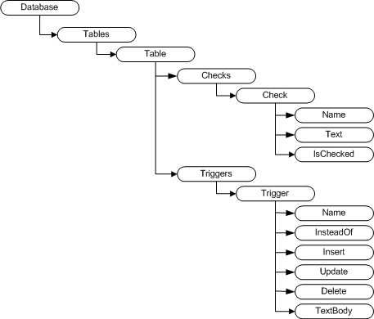
The Database Object - Tables

Slide 26
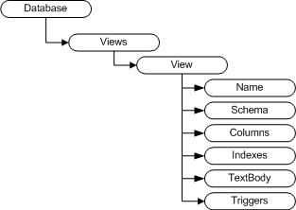
The Database Object - Views

Slide 27
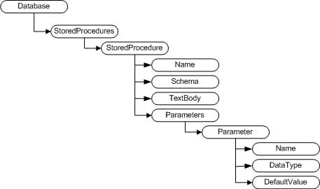
The Database Object – Stored Procs

Slide 28
Part 3: Scripting Database Objects
The SMO Scripter Object
Scripting the Scripts

Slide 29
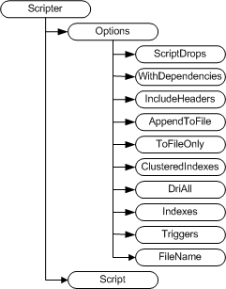
The Scripter Object

Slide 30
Scripting the Scripts
Three Parameters
SQL Instance, Database, Base Directory
Load libraries and define error trapping
Instantiate the Server and Database Objects
Create the Database Directory
For Each Object Type
Create Type Directory
Script the Objects

Slide 31
The PowerShell Script
Use a Param Block for Arguments
# Get the SQL Server instance name, database and base directory from the command line
param(
[string]$inst=$null,
[string]$dtbase=$null,
[string]$base=$null
)
Load the SMO Libraries
Trap for Errors
# Handle any errors that occur
Trap {
# Handle the error
$err = $_.Exception
$errmsg = $err.Message
while( $err.InnerException ) {
$err = $err.InnerException
$errmsg = $errmsg + "|" + $err.Message
};
[Diagnostics.EventLog]::WriteEntry($s.Name ,"Job Error: $errmsg","Error")
# End the script.
break
}

Slide 32
Prepare the Environment
Connect to the Instance and Database
# Connect to the specified instance
$s = new-object ('Microsoft.SqlServer.Management.Smo.Server') $inst
# Connect to the specified database
$db = $s.Databases[$dtbase]
$dbname = $db.Name
Create the Database Directory
# Create the Database root directory if it doesn't exist
if (!(Test-Path -path "$base\$dbname\"))
{
New-Item "$base\$dbname\" -type directory | out-null
}
$homedir = "$base\$dbname\"

Slide 33
Instantiate the Scripter object
Create the Object and Set Properties
# Instantiate the Scripter object and set the base properties
$scrp = new-object ('Microsoft.SqlServer.Management.Smo.Scripter') ($s)
$scrp.Options.ScriptDrops = $False
$scrp.Options.WithDependencies = $False
$scrp.Options.IncludeHeaders = $True
$scrp.Options.AppendToFile = $False
$scrp.Options.ToFileOnly = $True
$scrp.Options.ClusteredIndexes = $True
$scrp.Options.DriAll = $True
$scrp.Options.Indexes = $True
$scrp.Options.Triggers = $True

Slide 34
Script the Objects
For Each Object Type
Create a Directory for the Type
Script out the Objects
# Script the tables in the database
$db.Tables | foreach-object {
if($_.IsSystemObject -eq $False) {
$tbl = $_
if (!(Test-Path -path "$homedir\Tables\"))
{
New-Item "$homedir\Tables\" -type directory | out-null
}
$tblname = $tbl.Name
$scrp.Options.FileName = "$homedir\Tables\$tblname.sql"
$scrp.Script($tbl)
}
}

Slide 35
Demo

Slide 36
Load to Source Control
Load Scripts from Base Directory
Modify Script to add Date String to Base Name
Allows you to run script daily
Protects you from changes made in objects
“Documents” Database Objects for Auditors

Slide 37
Next Steps
28 day free trial at red-gate.com
$99 license for all webinar registrants
Email Michael.Christofides@red-gate.com
Quote code webinarssc1811
One license per organization
Offer open until November 25th 2010
More webinars – red-gate.com
Any Questions?

